Slide 1
Week 4 Data Analysis

Slide 2
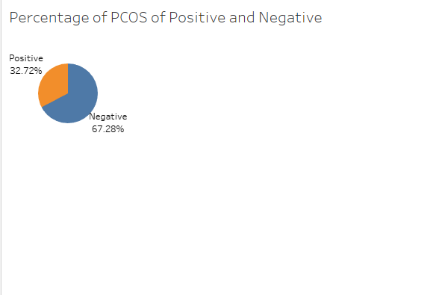
Percentage of PCOS Positive and Negative Patients
In the given dataset only 32.72% of people are PCOS of Positive

Slide 3
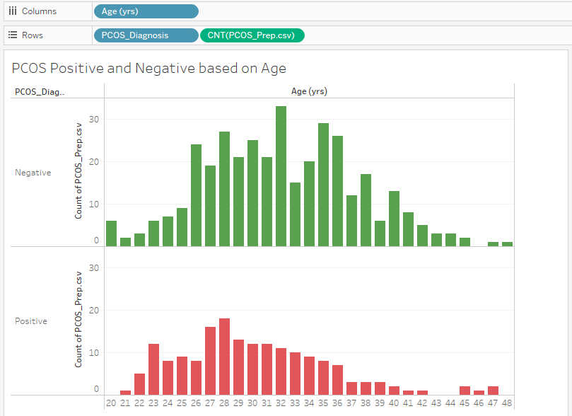
Trend of PCOS Age-Wise
It can be observed from the above image after the age of 20 females get PCOS disease and most of the females get PCOS positive after the age of 25 years

Slide 4
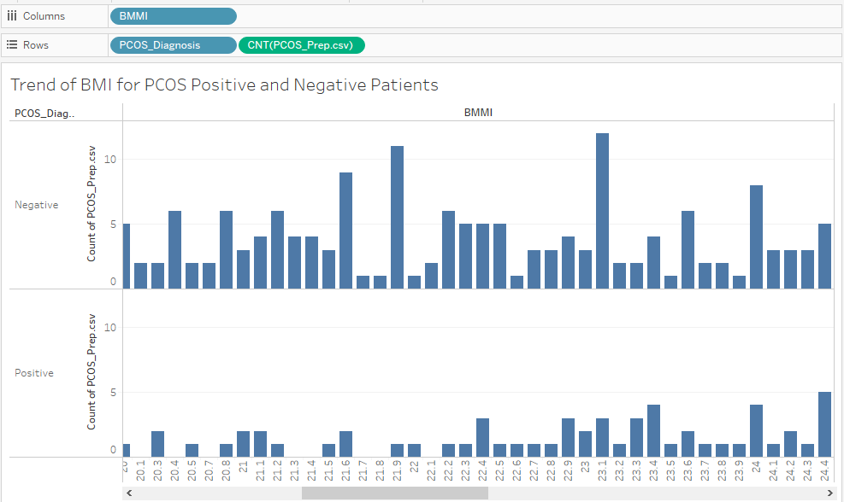
Trend of BMI with PCOS
As it be observed from the above image patients with PCOS positive have BMI more than 20 and it can be observed that higher BMI leads to PCOS

Slide 5
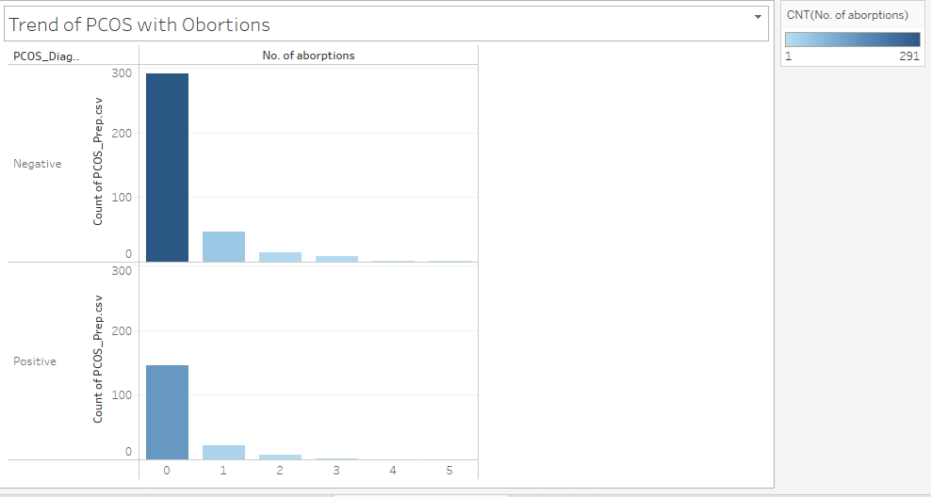
Trend of abortions with PCOS
There is no such correlation with number of abortions and PCOS. Females who have no abortions have higher number of PCOS positive

Slide 6
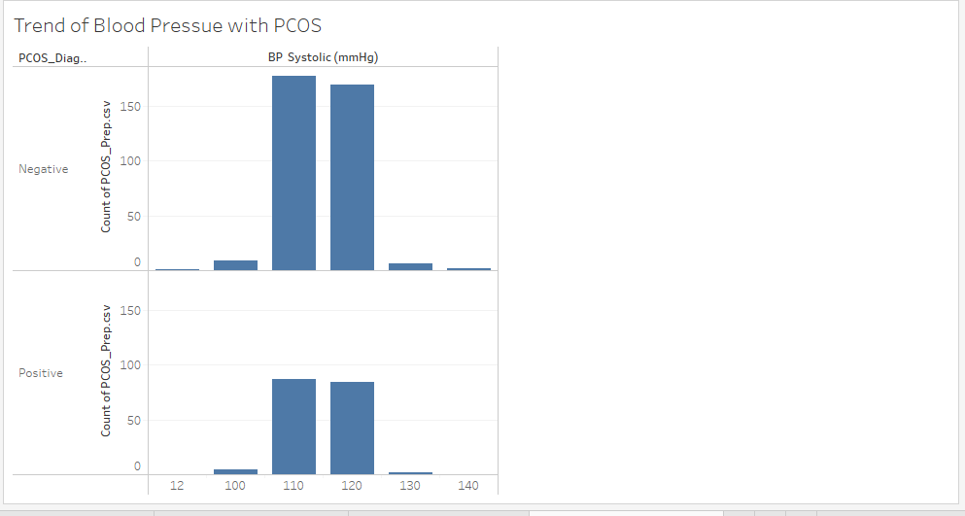
Trend of Blood Pressure with PCOS
Blood pressure is also not a symptom of PCOS positive it can be seen from above image. Females who are positive of PCOS disease they 120 systolic blood pressure which is a normal blood pressure

Slide 7
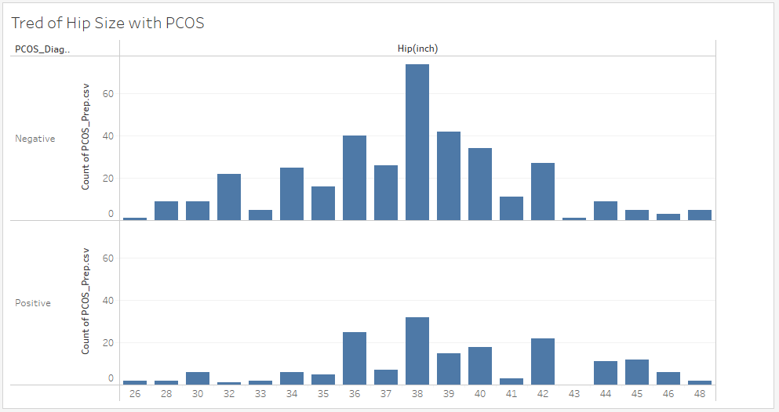
Trend of Hip Size with PCOS
There is no such trend with Hip size and PCOS people who don’t have PCOS and people who have PCOS have the same hip size

Slide 8
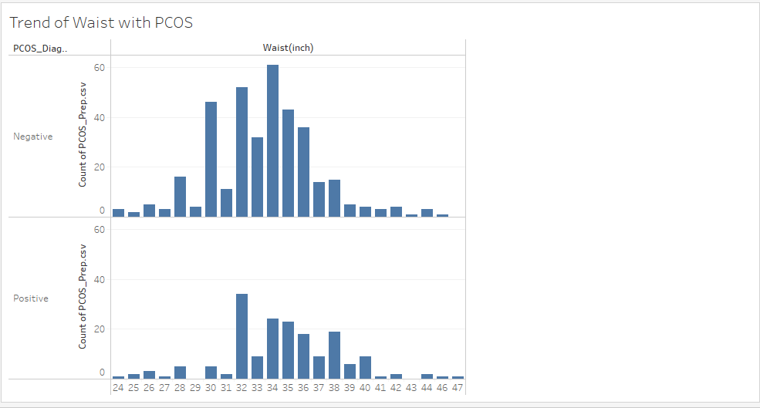
Trend of Waist with PCOS
It can be observed that as the waist increase the chances of PCOS positive also increases. Waist and PCOS are positive correlated it can be observed from above picture

Slide 9
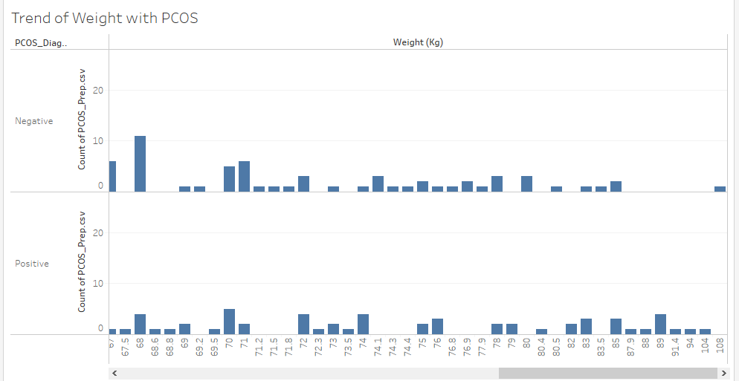
Trend of Weight with PCOS
It can be observed that increase of weight doesn’t lead to PCOS disease from above picture

Slide 10
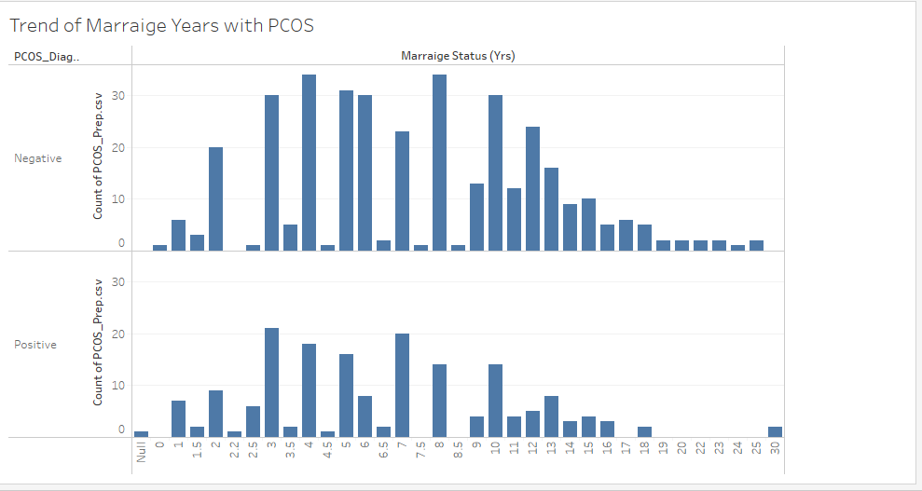
Trend of Marriage Years with PCOS
Again Marriage Years are not playing a role in PCOS disease

Slide 11
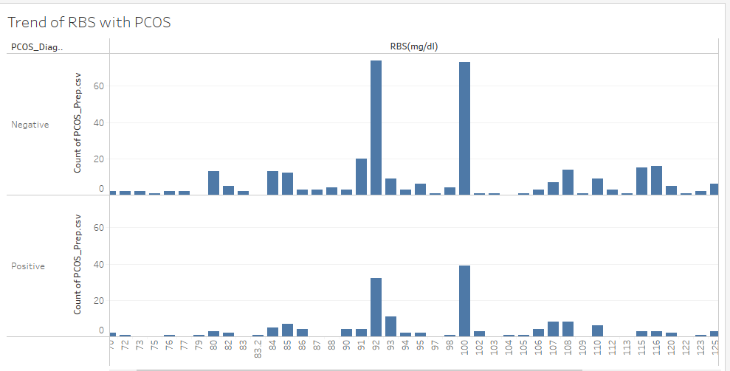
Trend of RBS with PCOS
Increase in RBS or decrease in RBS is same like the patients who don’t have PCOS

Slide 12
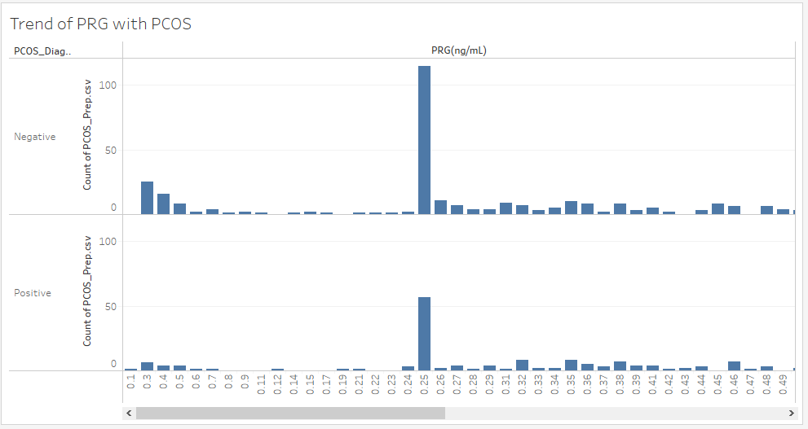
Trend of PRG with PCOS
Either a patient is PCOS Positive or Negative PRG is not correlated to this disease

Slide 13
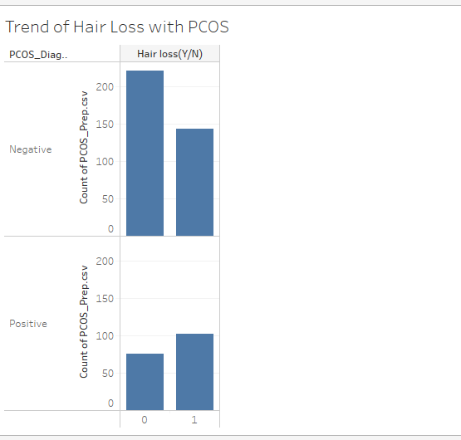
Trend of Hair Loss with PCOS
It can be observed that patients who are PCOS positive they also have the hair loss

Slide 14
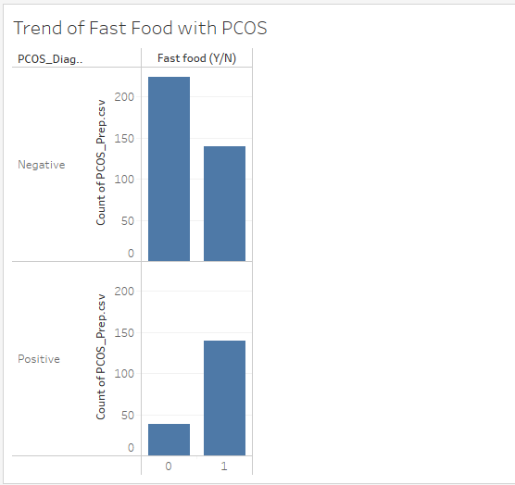
Trend of Fast Food with PCOS
People who are eating fast food they have chances of PCOS disease

Slide 15
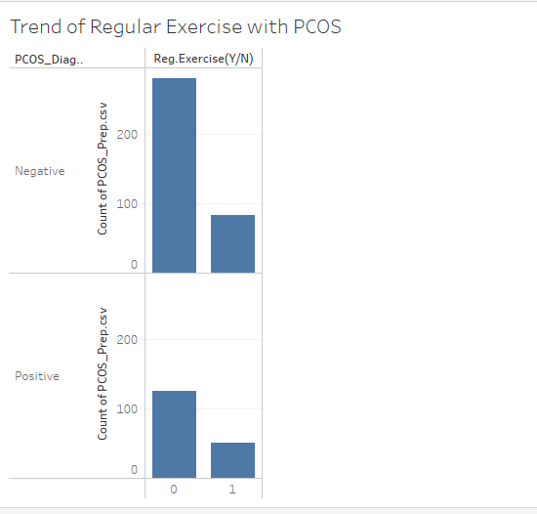
Trend of Exercise with PCOS
It can be observed that patients who do regular exercise they don’t have PCOS and patients who don’t regular exercises they have chances of PCOS

Slide 16
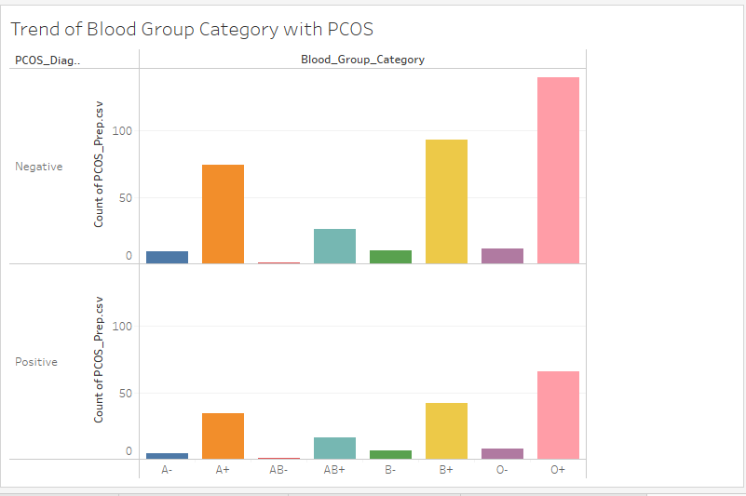
Trend of Blood Group Category with PCOS
Females who have Blood group O+ have higher chances of PCOS disease

Slide 17
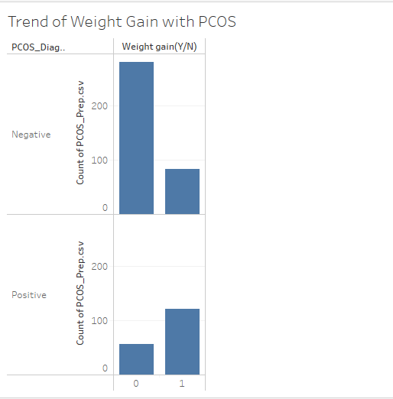
Trend of Weight Gain with PCOS
Females who got weight gain have higher chances of PCOS disease

Slide 18
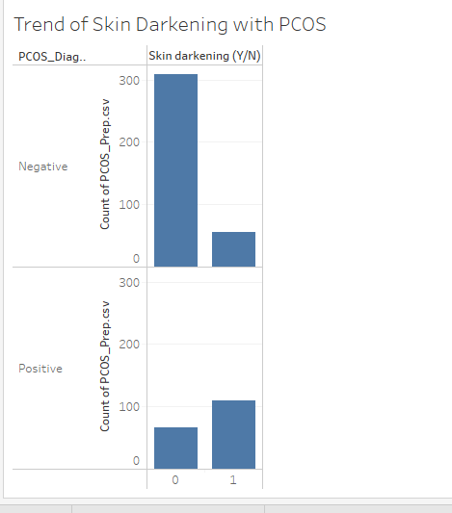
Trend of Skin Darkening with PCOS
Females who got skin darkening have higher chances of PCOS disease

Slide 19
Analysis Summary
After performing the Data Analysis on PCOS dataset we are able to find out the symptoms which leads to PCOS disease. These are the following symptoms which could lead to PCOS:
Skin Darkening
Weight Gain
Hair Loss
Follicle No (L and R)
Cycle
Fast Food

